Slide 1
Going Live!
Chris Human ©2023

Slide 2
The Journey So Far!

Slide 3

The Journey So Far!
In just two whirlwind weeks we’ve covered:
Full-Stack Development Conceptually
Terminal
Git Concepts and Commands
HTML Syntax
CSS Purpose, Syntax, and Styles
Floating
Positioning
Box Model
Chrome Dev Tools
How to Learn on Your Own!!

Slide 4
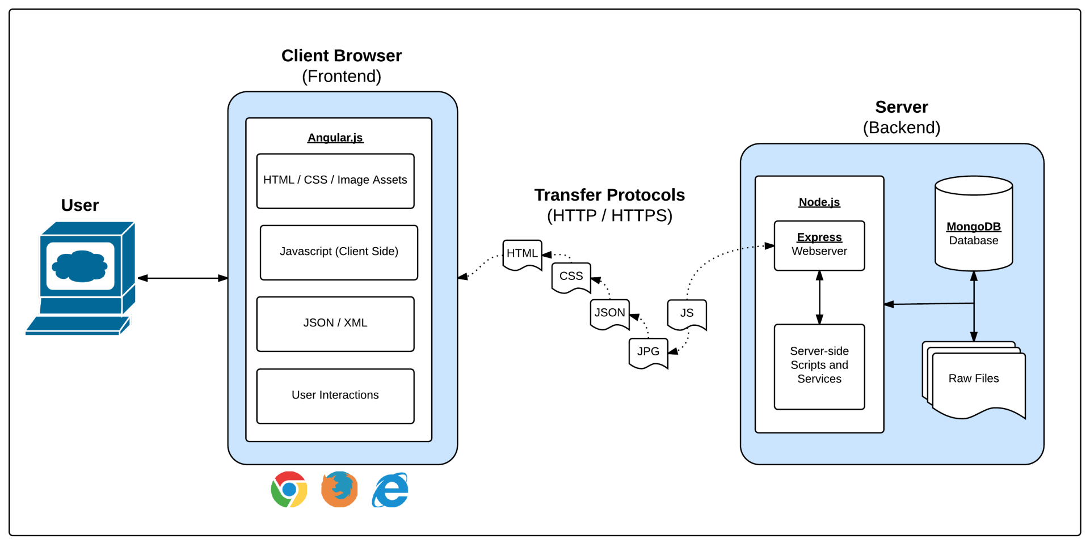

Full-Stack Development?

Slide 5
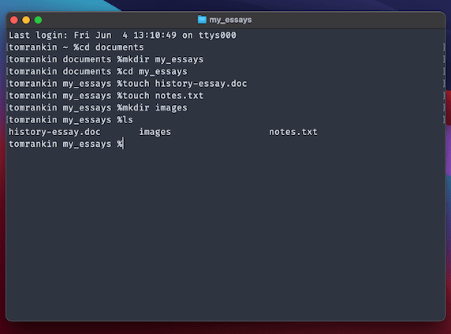
Intro to Console / Terminal

Slide 6

<title> Intro to HTML </title>
HTML (HyperText Markup Language) is one of the 3 base languages behind every single website.
It defines all of the basic content and a bit of formatting
Notes:
Hypertext - Links between systems or, in this case, websites.
Markup language - System by which symbols are inserted into text documents to control structure, formatting, and relationships

Slide 7

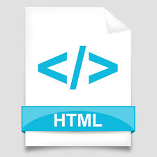



Pulling and Pushing to GitHub
1
2
3
4
GitHub Branch
Pull Code
Push Code
Pull Code
Pull Code
Push Code
Pull Code
Push Code

Slide 8

CSS Syntax
CSS works by hooking onto selectors added into HTML using classes and identifiers.
Once hooked, we apply styles to those HTML elements using CSS.

Slide 9

The Concept of “Flow”
By default, every HTML element displayed in the browser is governed by a concept called flow.
This means that HTML elements force their adjacent elements to flow around them.

Slide 10
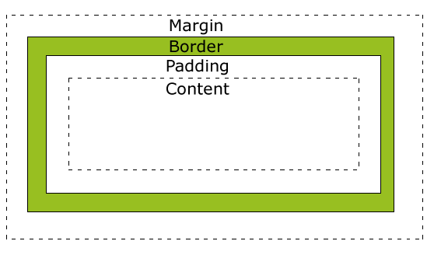
Boxes Upon Boxes
In CSS, every element rests within a series of boxes.
Each box has customizable space properties:
margin, border, and padding.

Slide 11
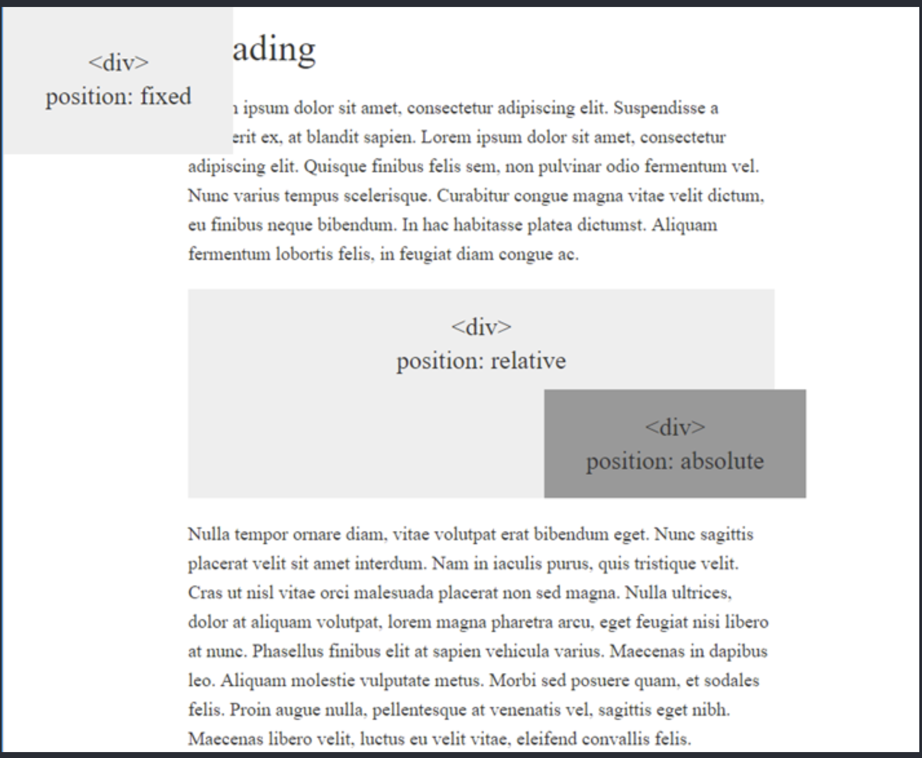
CSS Positioning
We can orient our HTML elements in relation to space with CSS positioning (static, relative, fixed, absolute).

Slide 12




How to Learn…

Slide 13

General Questions / Issues?

Slide 14
Recap!

Slide 15
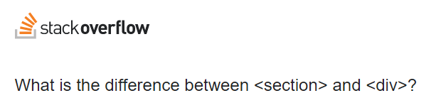
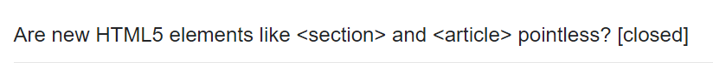
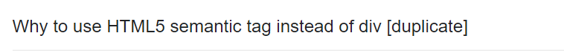
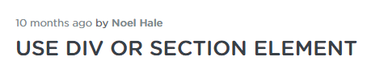
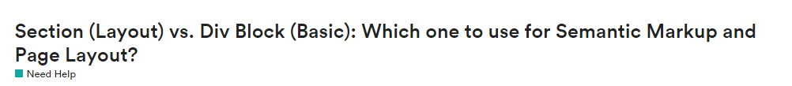
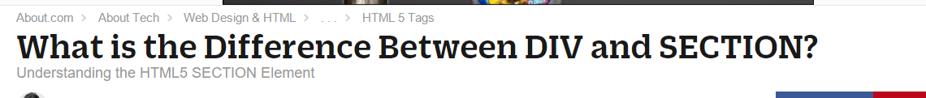
Divs, Sections, Navs, Etc…

Slide 16
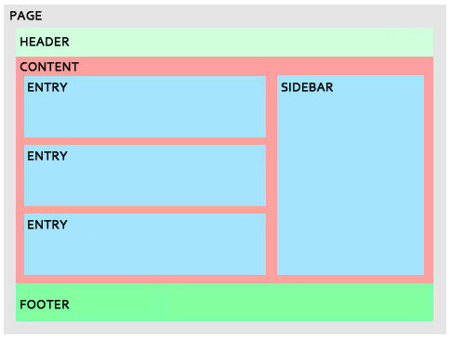
Divs, Sections, Navs, Etc…
All web layouts are inherently composed of containers, traditionally called “divs.”

Slide 17
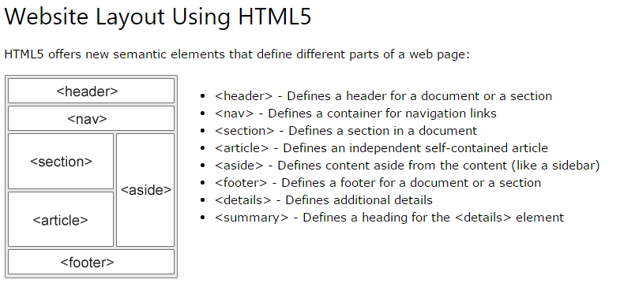
Divs, Sections, Navs, Etc…
HTML5 introduced the concept of “semantic layouts,” meaning “divs” could be given more meaningful names.
In theory, this helps with organization and search engine optimization.

Slide 18
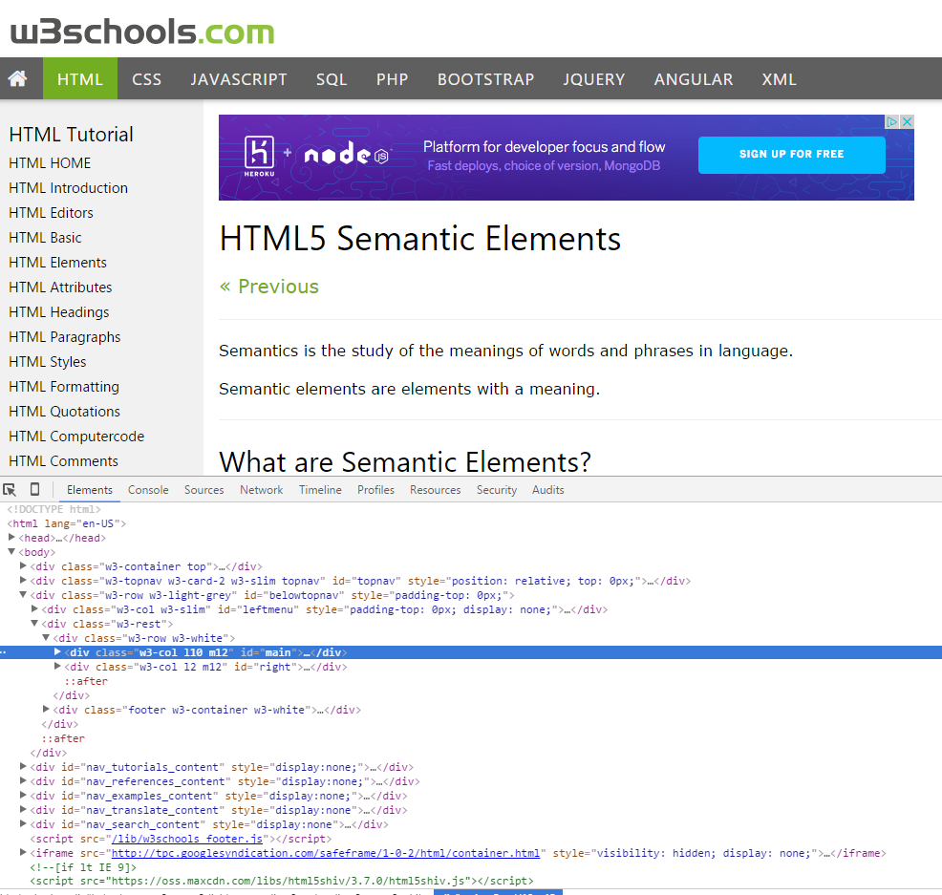
Divs, Sections, Navs, Etc…
That said… many (if not most) websites, seem to still be using basic divs.
There are reasons for this that we’ll showcase in later sections.
Additionally, it’s possible to include “semantics” by using id names and classes.

Slide 19
Divs, Sections, Navs, Etc…
div?
section?
Bottom line:
Follow your homework’s instructions. But when you get out in the “real world,” follow the convention of where you work!

Slide 20

Classes vs IDs
Classes = Barcode (all iPhones)
IDs = Serial Number (specific/unique iPhone)
When choosing between a CSS ID and a CSS Class follow the convention:
Classes (.classname) are to be used if the same style will be used on multiple HTML elements.
IDs (#idname) are to be used if a style is unique to that HTML element.
Notes:
Hypertext - Links between systems or, in this case, websites.
Markup language - System by which symbols are inserted into text documents to control structure, formatting, and relationships

Slide 21
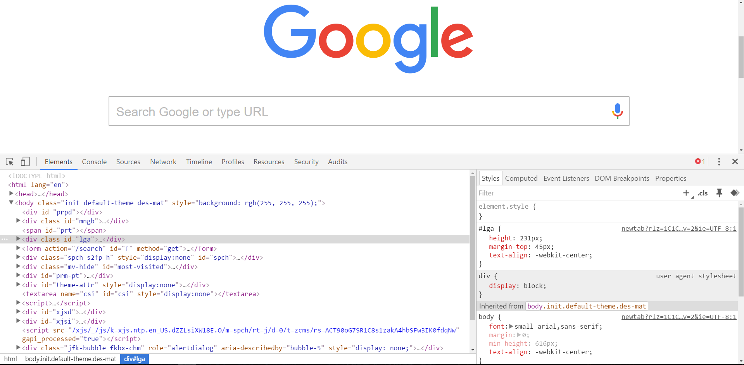
Chrome Developer Tools (i.e. Inspector)
This is one of the most frequent tools you will use in web development.
It allows you to truly debug your web designs.
Start using it!
You can edit any page’s HTML and CSS with Chrome Developer Tools.
Plus, you’ll see your results instantly.

Slide 22

Loading Multiple CSS Files
We can link our documents to more than one stylesheet at a time—one of the most powerful features of CSS/HTML.
By tapping into different stylesheets simultaneously, we can create complex layouts with plenty of design rules.
Just remember: the loading order matters!!!

Slide 23
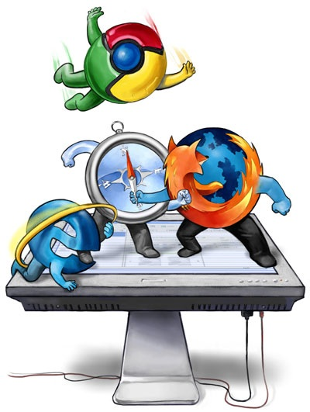
Battle of the Browsers
Under the hood, web browsers often render webpages differently than their competition.
These disparities could mean HTML/CSS displaying differently in each web client.
Because of these potential divergences, web developers need to make their websites cross-browser compatible.

Slide 24

Battle of the Browsers
Reset.css will “reset” all browser-specific CSS. This means your site will appear the same in all browsers.
However, you will have to re-style everything yourself.

Slide 25
Practice Through Frustration
KEEP PRACTICING!
It gets better and easier!

Slide 26
To the Web with GitHub!

Slide 27
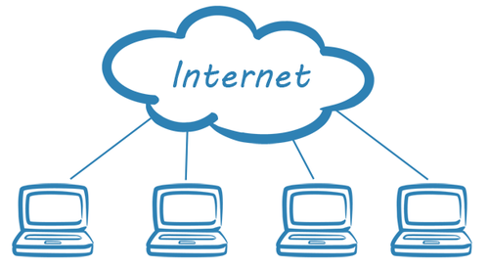
The Internet
A deep and complex diagram above on how the internet works.

Slide 28
GitHub Pages
GitHub provides hosting for static websites – which means we can deploy our websites and applications onto their servers for the world to see.

Slide 29
Your Turn!
Activity: GitHub Pages
Suggested Time: 5 min.
Assignment:
Take your portfolio to GitHub Pages!

